Slide 1
发展一致性 评估员的关键心理

Slide 2

学习成果
这一节结束后你将可以……
批判性地评估你自己对裁判员的反馈并认识到影响反馈质量和一致性的问题。
Notes:
In this short session, I really want you to evaluate your own performances as an AFC Assessor from last year, what did you do well and what do you need to improve in your performance. Consistency in development is critical no matter which country from AFC you are from. We are all AFC Assessors we need to assess the referees on their performance and not because who they are.

Slide 3


往事无法改变，但未来仍由你掌控。
佚名
未来在你们的手中
Notes:
Every time you attend a match as an assessor, you have a great opportunity to add value to the future performances of the referees. I would ask you just one moment of pause, ask yourself this question: Have I completed the assessment accurately and offered quality feedback? Before you click the mouse button to confirm your assessor's report

Slide 4

裁判评估员
…更多地作为帮助裁判员在以后更好表现的教练…
Notes:
One of the most difficult responsibilities assessors find is how to give advice that will help the referees to improve their future performances. Too often we fall into the trap of telling the referees what we would do in the same situation rather coaching the referee to come up with their own solution. Sometimes the feedback can be trivial and demotivate the referees

Slide 5

吹毛求疵的人鸡蛋里也可以挑出骨头来。
Notes:
One of the most difficult responsibilities assessors find is how to give advice that will help the referees to improve their future performances. Too often we fall into the trap of telling the referees what we would do in the same situation rather coaching the referee to come up with their own solution. Sometimes the feedback can be trivial and demotivate the referees

Slide 6
评估员的职责
找到错误很简单，但是给出如何提升表现的建议就不那么简单了。
…不要只做找到错误的人 – 做一名影响表现的人!
Notes:
One of the most difficult responsibilities assessors find is how to give advice that will help the referees to improve their future performances. Too often we fall into the trap of telling the referees what we would do in the same situation rather coaching the referee to come up with their own solution. Sometimes the feedback can be trivial and demotivate the referees

Slide 7


评估员的职责
Notes:
When we want to develop our top referees, we need to consider the root causes to their performance improvement both positive and development areas and not just focus on the mistakes. Wind the performance back, what happened and was this the cause?

Slide 8

评估员的职责
不要扬汤止沸 – 记得釜底抽薪
Notes:
This is a very interesting slide and one which I want you to take with you every time you assess the performances of all the referees. Having strong roots gives us great stability and with greater stability, much improved and consistent future performances. Make our referees strong with quality advice, using your experience to guide and support.
Picture Courtesy of Alistair Smith Learning

Slide 9

亚足联评估方案
评估员增加价值
裁判员得到价值
亚足联提高价值
Notes:
Every assessment scheme, it doesn’t matter which country should always add value from the assessor, gains value for the referees and more importantly, gives value to AFC for ensuring the right people are promoted, have the right people refereeing the top matches and for our top referees to be recognised on the international stage.

Slide 10
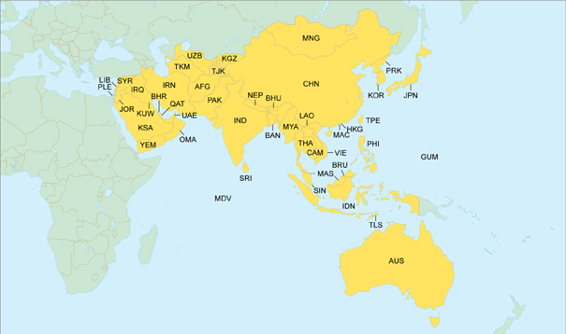
发展中如何保持一致？
Notes:
We all follow the same Laws of the Game yet there is different interpretations on the application of the Laws. This is why these seminars are so important to calibrate our understanding, close the gap and agree decisions collectively.

Slide 11

我们需要给予我们反馈的人。这是我们进步的方法。 ——比尔·盖茨

Slide 12
小组训练
如何优先化反馈?
与和你同桌的人一起讨论在优先化反馈裁判员发展时你要考虑的因素。

Slide 13

为什么我们要优先化反馈？
裁判员
控制比赛
比赛管理
体能和选位
团队合作
Notes:
Use the assessment form to help guide you in your feedback. But ensure the advice has some meaning and relevance to the referees

Slide 14
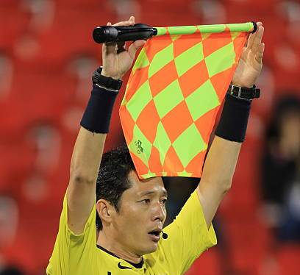
我们如何优先化反馈？
助理裁判员
决定和信号的准确性:越位,犯规,界外球,球门球等.
旗示技巧,选位和移动
Notes:
Use the assessment form to help guide you in your feedback. But ensure the advice has some meaning and relevance to the referees

Slide 15
优先化你的反馈
重要
紧急且重要
需要提升
重要但不紧急
需要慢慢提升
紧急
不紧急
紧急但不重要
有帮助性的,不要批评
不紧急不重要
避免或忽略
不重要
Notes:
As with every match, it is important that we sort the important from the unimportant and the urgent (need to do immediately) to the non urgent, minor faults that does not need to be discussed.

Slide 16





报告中常见错误(附解释)
不要对小事过于紧张
不要遇到:
不清楚
迷失
不确定
困扰
不要使用谷歌翻译(机器翻译)
不要复制粘贴

Slide 17
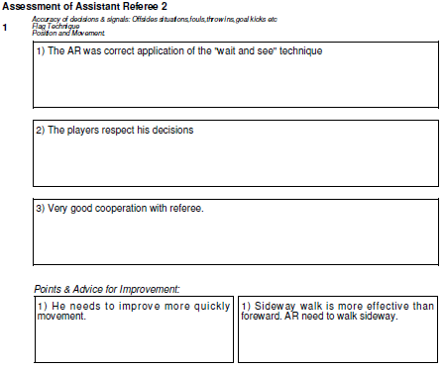
报告样例
非常好的表现
中等难度
助理正确地使用了”等和看”的技巧
队员尊重他的决定
助理裁判员
8.7分
和裁判员很好地配合
侧滑步比往前走更有效.多用侧滑步.
移动需要更快

Slide 18
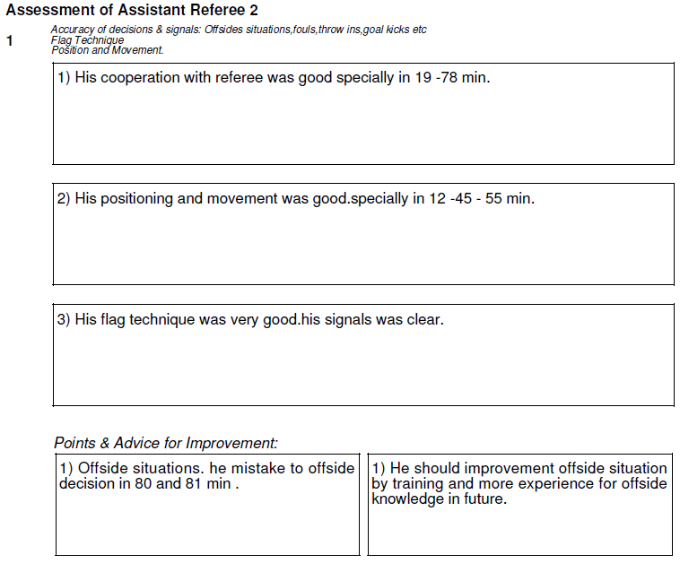
好的表现
中等难度
19-78分和裁判员配合的好
选位和移动很好,尤其是在12-45-55分钟
助理裁判员
8.4分
旗示技巧很好,信号清楚.
越位.80,81分钟错判越位.
应通过今后的训练和更多越位知识经验提升对越位的判断

Slide 19
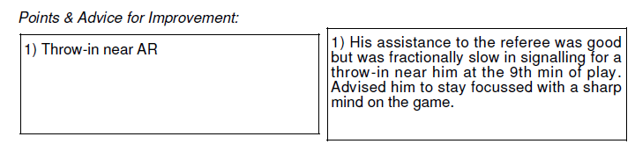
助理近端界外球
对裁判员的协助很好,但第九分钟在他近端的界外球给出信号有些慢.建议他以敏锐的眼光专注于比赛.
大建议/小建议还是不要提?

Slide 20
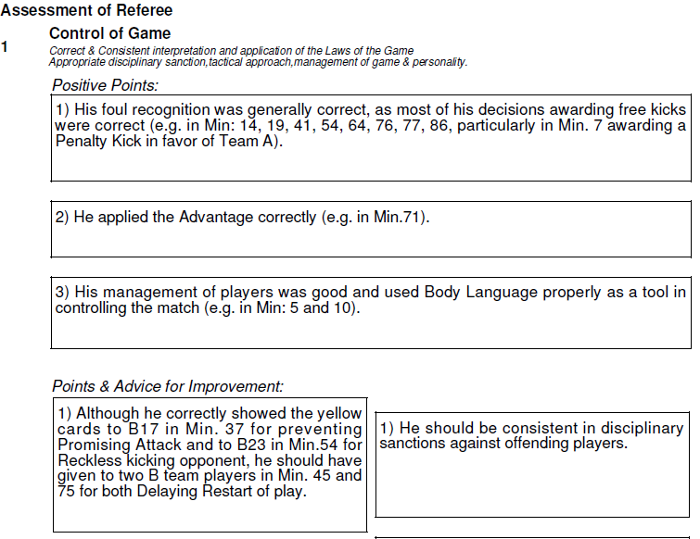
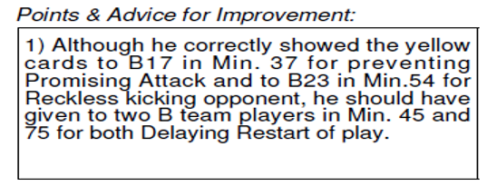
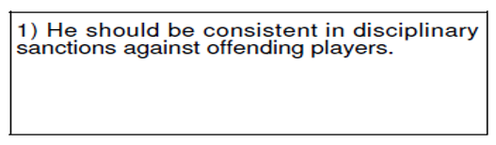
Good Performance
Medium Difficulty
Referee Mark
8.4
应对犯规队员的纪律处罚保持一致.

Slide 21
反馈指南 – 建议
评估报告
正向点
在决定中使用有时间的参考点（不是所有决定）
介绍你看到了什么 – 证据（简要地）
正向点应解释你的评分

Slide 22
Assessment Guidelines – Advice
评估报告
提升建议
在明显影响表现的事件注解有时间的参考点
使用你的经验提供如何改进表现的建议
不好的点应该影响你的评分

Slide 23
问题?

Slide 24
Summary
优先化实力和可改进的方面
建设性评论
建议和支持
激励他人的能力

Slide 25
不要扬汤止沸 – 记得釜底抽薪

Slide 26
谢谢

